Slide 1


Slide 2



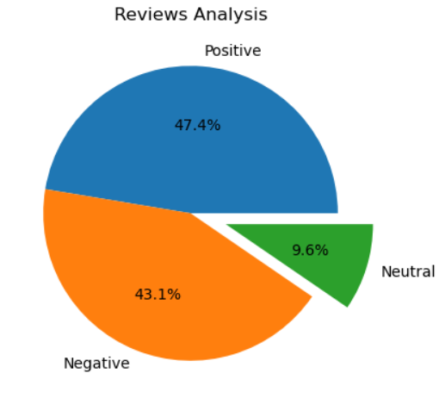

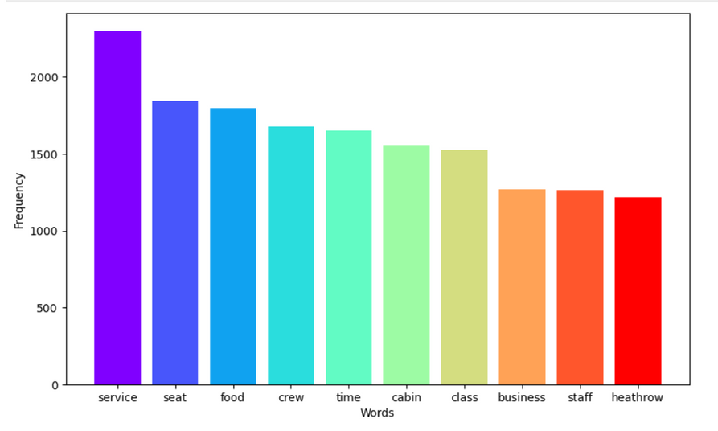
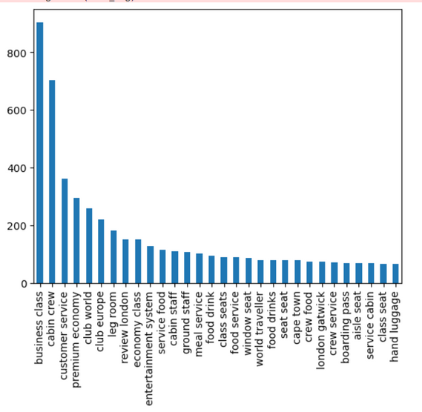
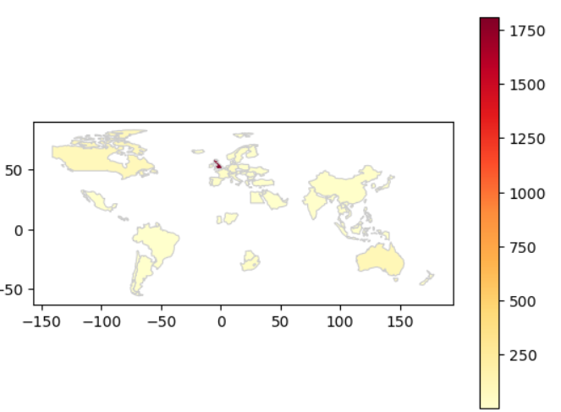

KEY MATRIX
2900
Reviews
Collected
66
Countries
Avg Ratings
4.5/10
Review Analysis Pie diagram shows overall reviews of the customer is positive, BA doing well in over all.
N gram telling us that Cabin Crew are very helpful and customer service is well enough
Word Cloud and word frequency graph both indicating SEAT, SERVICE, FOOD need to be improved.
Country density graph clearly indicating the Company is totally based on UK

